Slide 1
Monitoring the Environment
Global Warming

Slide 2
Natural Greenhouse Effect
The Earth’s surface absorbs short-wave radiation from the sun (visible light and UV rays), which is then re-emitted as long wave infra-red (IR) radiation.
Some gases in the atmosphere trap part of this IR radiation, thereby warming the Earth’s atmosphere.
These gases are referred to as greenhouse gases. Common greenhouse gases include CO₂, H₂O and CH₄ (methane).
Their polar covalent bonds stretch and bend to absorb the IR radiation.
The mechanism by which these gases maintain a temperature in the Earth’s atmosphere that can support life is known as the Natural Greenhouse Effect

Slide 3
Enhanced Greenhouse Effect
Human activities affect the concentration of certain greenhouse gases
They therefore have the potential to disrupt the thermal equilibrium of the atmosphere.
An increase in the concentration of greenhouse gases in the atmosphere trap a greater amount of IR radiation.
The net result is that the temperature of the Earth’s atmosphere is raised.
This is known as the enhanced greenhouse effect.

Slide 4
Enhanced Greenhouse Effect
Cause
Burning carbon based fuels
Deforestation
Agriculture – rice paddies, cows, sheep, natural gas fields, industrial activities, garbage dumps
Effect
Increased CO2 Emissions
Decreased CO2 conversion via photosynthesis
Increased CH4 emissions

Slide 5
Predicted Effects
Increase in global temperature
Rise in sea levels due to water expansion at higher temperatures
Disruption of ecosystems
Climate change and shift in weather patterns
Melting polar ice caps

Slide 6
Possible Solutions
Plant more trees
Reduce emissions
Burn less carbon-based fuels
Use alternative energy sources
Capture and storage of CO2 emissions

Slide 7
Ocean Acidification
As well as liquids and solids, gases can also be soluble in water.
Oxygen for example is soluble in water and is vital for the survival of aquatic plants and animals.
Carbon dioxide is also soluble in water.
CO_{2(g)} ⇌ CO_{2(aq)}
As the concentration of carbon dioxide in the atmosphere increases, so too will the dissolved carbon dioxide content.

Slide 8
Oxides
Carbon dioxide is a non-metal oxide.
Non-metal oxides are acidic
CO_{2(aq)} + H₂O_{(l)} ->
Carbon dioxide + water goes to carbonic acid

Slide 9
Acids and Bases Review
Acids are proton donors
Bases are proton acceptors
Acids ionise when dissolved in water
H₂CO₃ + H₂O ->
pH = -log[H⁺]
[H+] = 10^{-pH}
The skeletons and shells of many marine organisms are made of calcium carbonate
H⁺ + CaCO₃ ->

Slide 10
Monitoring the Environment
Photochemical Smog

Slide 11
Oxides of Nitrogen
Nitrogen comprises 78% by volume of the atmosphere. It exists as stable triple covalently bonded N₂ molecules and is chemically very stable.
High temperature furnaces and combustion engines can provide the large amount of activation energy required to break the N₂ triple bonds
N_{2(g)} + O_{2(g)} → 2NO_{(g)}
NO can then further react with oxygen to form nitrogen dioxide
2NO_{(g)} + O_{2(g)} → 2NO_{2(g)}
Oxides of nitrogen are harmful to both animal and plant life
They are also a major contributor to acid rain

Slide 12
Photochemical Smog
Photochemical smog is a special kind of smog caused by pollutants
Primary pollutants are chemicals released directly into the environment from human activity
Examples include NO, CO, CO₂ and unburnt hydrocarbons known as volatile organic compounds (VOC’s)
Secondary pollutants are formed by reactions of primary pollutants with air, water or sunlight
Examples include NO₂, O₃ and other organic compounds

Slide 13
Photochemical Smog
Formation of photochemical smog is favoured by certain weather conditions, eg windless sunny days
Temperature inversion can lead to smog being trapped
Temperature inversion begins on calm clear nights when the Earths surface rapidly cools
The air near the ground then becomes cooler than the air above
This colder, denser layer then traps any smog formed during the day, giving more time for primary pollutants to react
This can last for several days until broken up by winds

Slide 15
Formation of Ozone
Ozone is considered a pollutant when formed in the troposphere
Ozone causes yellowing of plant leaves and a reduction of photosynthesis
Ozone is a respiratory irritant, causing coughing and restriction of airways
It also causes rubber to harden and crack, affecting rubber seals
Ozone is formed when intense sunlight and high concentrations of NO₂ are found
Sunlight splits an oxygen atom from the NO2 to form NO and a highly reactive oxygen atom
NO₂ ➔ NO + O
The oxygen atom then reacts with oxygen gas to from ozone
O + O₂ ➔ O₃

Slide 16
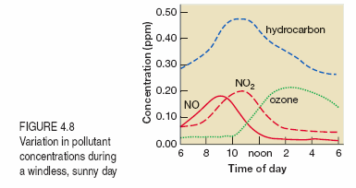
Photochemical Smog
The concentration of primary pollutants generally rises sharply during peak morning traffic
The peak concentration of secondary pollutants generally occurs later in the day as the primary pollutants are converted by sunlight
The peak concentration of ozone then occurs during the afternoon

Slide 17
Catalytic Converters
Catalytic converters can reduce the amount of pollutants coming from a cars exhaust
They have a simple design, but are expensive due to the catalyst metals required (often an alloy of platinum and rhodium)
The platinum speeds up reactions with oxygen
CO and unburnt hydrocarbons produced from incomplete combustion are oxidised
Rhodium helps to convert NO into nitrogen and CO₂
2CO_{(g)} + 2NO_{(g)} ➔ N_{2(g)} + 2CO_{2(g)}
2NO_{(g)} + 4H_{2(g)} N_{2(g)} + 2H₂O_{(g)}

Slide 18
Monitoring the Environment
Analytical Chemistry

Slide 19
Mole
Amount of a substance
A way to compare amounts of substances that react
The number of particles in 12.000g of carbon-12
Equivalent to Avagadro’s Number: 6.02 x 10²³

Slide 20
Molar Mass
Can be derived from the periodic table
4 significant figures
m = n M n = m / M M = m / n
Units of g mol⁻¹

Slide 21
Significant Figures
Final answer to contain the same number of significant figures as least precise piece of data
Do not round until final answer
Count from first non zero digit
With a decimal point, zeros at the end count
Without a decimal point zeros at the end do not count

Slide 22
Supportive Questions
Calculate the number of moles in 2.2g of CO₂
m = n M n = m / M
n = 2.2 / (12.01 + 16.00 x 2)
n = 0.050 mol (2 sf)

Slide 23
Supportive Questions
Calculate the mass of 0.200 mol of Na₂CO₃.
m = n M
m = 0.200 x (22.99 x 2 + 12.01 + 16.00 x 3)
21.198 g
21.2 g (3sf)

Slide 24
Concentration
Concentration can be described using many different standard conventions. In general it is:
$\frac{amount of solute }{amount of solvent }$
We can use the units of the concentration to determine what the units of the solute and solvent should be. Some common units of concentration are mol L⁻¹ and g L⁻¹.

Slide 25
Concentration
mol L⁻¹ (moles per litre) = n (moles) / V (litres)
g L⁻¹ (grams per litre) = mass (grams) / V (litres)
% w/v (percent weight per volume) =
mass (grams) / 100 mL
ppm (mg L⁻¹) (parts per million) =
mass (milligrams, mg) / V (litres)
ppb (μg L⁻¹) (parts per billion) =
mass (micrograms, μg) / V (litres)

Slide 26
Molar Concentration
Concentration involving moles is also referred to as molarity
Molar concentration (C) measures in mol L⁻¹
C = n / v
You will occasionally see molarity written using M, eg 0.2M is equivalent to 0.2 mol L⁻¹

Slide 27
Supportive Questions 2
Calculate the molarity when 0.20 mol of HCl is dissolved in 500.0 ml of water.
C = n / v
C = 0.2 / 0.5
C = 0.40 mol L⁻¹

Slide 28
Concentration
The concentration conversion table: know it, love it
mol L⁻¹
ppm
x1000
xM
g L⁻¹
x1000
x10
x10⁶
ppb
%w/v
Hint: moving left you divide, moving right you multiply

Slide 29
Mole Ratios
A balanced equation provides the mole ratios of the substances that react or are produced during a reaction
We can use these ratios to calculate unknown quantities
The relative amounts (in moles) of substances reacting or produced during a reaction are indicated by the coefficients in the balanced equation for the reaction

Slide 30
Supportive Questions 3
Complete combustion of propanol
C₃H₇OH_{(g)} + O_{2(g)} CO_{2(g)} + H₂O_{(g)}
Propanol : Oxygen = 1:4½ or 2:9
Propanol : Carbon dioxide = 1:3

Slide 31
Supportive Questions 3
m = n M n = m / M
n = 220 / (12.01 x 3 + 8 x 1.008 + 16)
n = 3.66 mol
$\frac{n_{(O_{2})}}{n_{(C_{3}H_{7}OH)}} = \frac{4.5}{1}$
n = 4.5 x 3.66
n = 16.47 mol
m = 16.47 x (16 x 2)
m = 527.17 g
m = 530 g (2sf)

Slide 32
Titration
A titration is a technique that enables a chemist to measure the concentration of a substance in a solution.
It involves using glassware that is calibrated for an exact volume.
This volumetric analysis, involving a titration is a quantitative analysis because it involves finding the amount of a substance in a solution
There are 3 practical tasks associated with titrations
preparation of the solutions
preparation of the glassware
performing the titration

Slide 33
Rinsing
Rinsing of the apparatus is important to ensure accurate and precise results
With each apparatus, we either want to control the concentration or the number of moles
To control the moles no more can be unknowingly added
Hence final rinse is with distilled water
To control the concentration, it cannot be diluted
Hence final rinse is with the solution about to be used

Slide 34
Rinsing
Volumetric flask and Conical Flask
Rinse with distilled water
Need to control moles of substance
Pipette and Burette
First rinse with distilled water
Final rinse with solution they will contain
Need to control the concentration of substance

Slide 35
Volumetric Flask
Weigh mass of solute on watch glass
Transfer to flask using dry funnel
Wash watch glass and funnel a number of time into flask
Half fill flask with water and swirl to dissolve
Add further water until level with meniscus
DO NOT overshoot the meniscus – you will have to start again!

Slide 36
Techniques: Pipette
Pipette should be held vertically
Fill so bottom of meniscus is at etched line – check at eye level
When draining, hold against the side of flask and allow to drain – don’t shake to remove last drop

Slide 37
Techniques: Burette
Burettes do not need to be refilled between titrations
Make sure to remove air bubbles, droplets on the side and the funnel
Use left hand turn – right hand swirl technique
Endpoint should be approached drop wise
Use wash bottle to ensure any liquid that leaves the burette reaches the reaction liquid

Slide 38
Monitoring the Environment
Chromatography

Slide 39
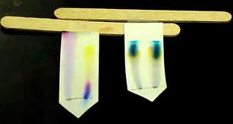
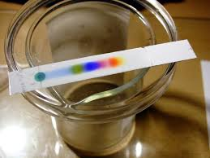
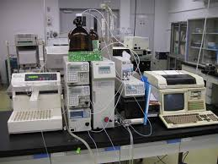
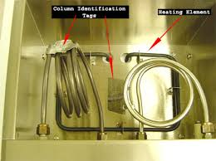
Chromotography

Slide 40
Chromatography
All forms of chromatography involve a mobile phase passing over a stationary phase
Chromatography separates different components by way of their different attraction to the mobile and stationary phase
The strength of this attraction is due to their relative polarities
Polar substances will adsorb onto the more polar phase

Slide 41
Polarity Revision
“Like dissolves like” – a good reminder, but never an answer to a question!
Polar bonds are caused by differing electronegativities causing uneven sharing of electrons
Polar molecules are asymmetrical molecules that contain polar bonds
Polar bonds attract each other via electrostatic interactions

Slide 42
Phase Interactions
If the mobile phase is polar:
The more polar chemical will adsorb more strongly to the mobile phase, and so will travel the furthest (in paper/TLC) and exit earlier (column/HPLC/GC)
Larger Rf and shorter retention time
If the stationary phase is polar
The more polar chemical will adsorb more strongly to the stationary phase, and so will travel the least distance (paper/TLC) and exit later (column/HPLC/GC)
Smaller Rf and longer retention time

Slide 43
Retardation Factor
Retardation Factor (Rf) is a measure of how far the solute travels relative to the solvent front
This enables comparisons between experiments
Rf = distance moved by solute
distance moved by solvent
Rf is dimensionless and always less than 1 (usually as a decimal)

Slide 44
Atomic Absorption Spectroscopy

Slide 45
Energy Levels
Electrons exist in specific shells of varying energy
Each shell has subshells, each with their own level of energy
Subshells are S, P, D and F
The subshells can hold increasing numbers of electrons
S can hold 2
P can hold 6
D can hold 10
F can hold 14

Slide 46
Naming Subshells
2p⁴
The 2 signifies the number of the main energy level
The p signifies the subshell
The 4 shows that there are 4 electrons in this subshell

Slide 47
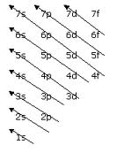
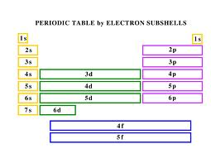
Filling Subshells
Subshells will fill in order of energy levels
Eg Fe: 1s² 2s² 2p⁶ 3s² 3p⁶ 4s² 3d⁶

Slide 48
Exceptions
Copper and Chromium do not exactly conform to these rules
Both have only 1 4s electron to gain a full and half full d shell respectively
Cr: 1s² 2s² 2p⁶ 3s² 3p⁶ 4s¹ 3d⁵
Cu: 1s² 2s² 2p⁶ 3s² 3p⁶ 4s¹ 3d¹⁰

Slide 49
Ions
For ions we simply add or subtract electrons equivalent to the charge on the ion
Always take electrons from the outer shell, which is not always necessarily the last one written down
Eg Na⁺: 1s² 2s² 2p⁶ 3s¹
F⁻ : 1s² 2s² 2p⁶ 3s²
Fe²⁺: 1s² 2s² 2p⁶ 3s² 3p⁶ 4s² 3d⁶

Slide 50
Electron configuration and absorption of energy
Electrons exist in finite energy levels.
The electronic configuration gives us the position of electrons in their ground state.
This is their most stable configuration and is achieved at room temperature.
An electron can absorb energy to move to a more excited state. They can do this in two ways:
Absorb heat: absorbs energy equal to the energy gap between electron energy levels
Absorb light: can only absorb the exact energy equal to the energy gap between electron levels

Slide 51
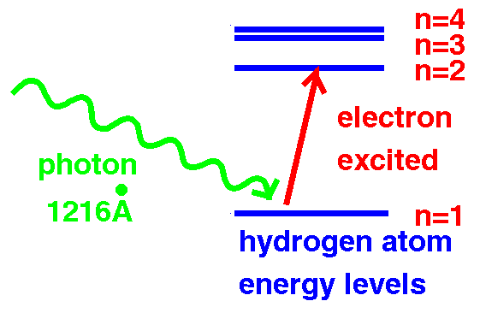

Slide 52
Emission Spectrum
Electrons are not stable in this excited state and quickly drop down, emitting a photon with the same energy as the corresponding energy gap between energy levels.
As this is a specific amount of energy, it will have a specific wavelength and hence colour.

Slide 54
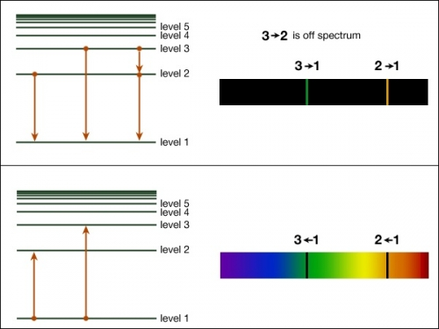

Slide 55
Flame Test
Qualitative test for metals in solution
Can also be used for coloured lights
This emission of light is called an emission spectrum

Slide 56
AAS
Involves the absorption of electromagnetic radiation of certain wavelengths
A spectrophotometer measures the intensity of the radiation transmitted through the sample relative to the intensity entering
Can therefore be used for quantitative measurements

Slide 57
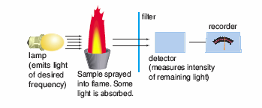
AAS

Slide 58
AAS – radiation source
Cathode lamp containing the metal to be analysed
Emits radiation of certain frequencies that correspond to the energy gaps characteristic of the metal sample
This means that impurities will not interfere with the measurements

Slide 59
AAS - flame
The radiation is directed through a flame into which the sample is sprayed.
Any metal atoms the same as the lamp will absorb the radiation emitted
The absorbance is proportional to the concentration of metal in the sample

Slide 60
AAS – filter and detector
A filter or monochromator is used to select the frequency of light to pass through to the detector
Allows AAS to be used with impure samples

Slide 61
Example
Concentration | Absorbance
2.0 | 0.051
4.0 | 0.097
6.0 | 0.148
8.0 | 0.201
10.0 | 0.253

Slide 62
Calibration Curve

